Slide 1
AQA GCSE Cell Structure
AQA Specification 4.1.1 Cell Structure

Slide 2
What are cells?
Cells are the basic unit of all forms of life.
In this section we explore how structural differences between types of cells enables them to perform specific functions within the organism.
These differences in cells are controlled by genes in the nucleus.
Explore Further:
Know the relative scale of cells - The Scale of the Universe: https://scaleofuniverse.com/

Slide 3
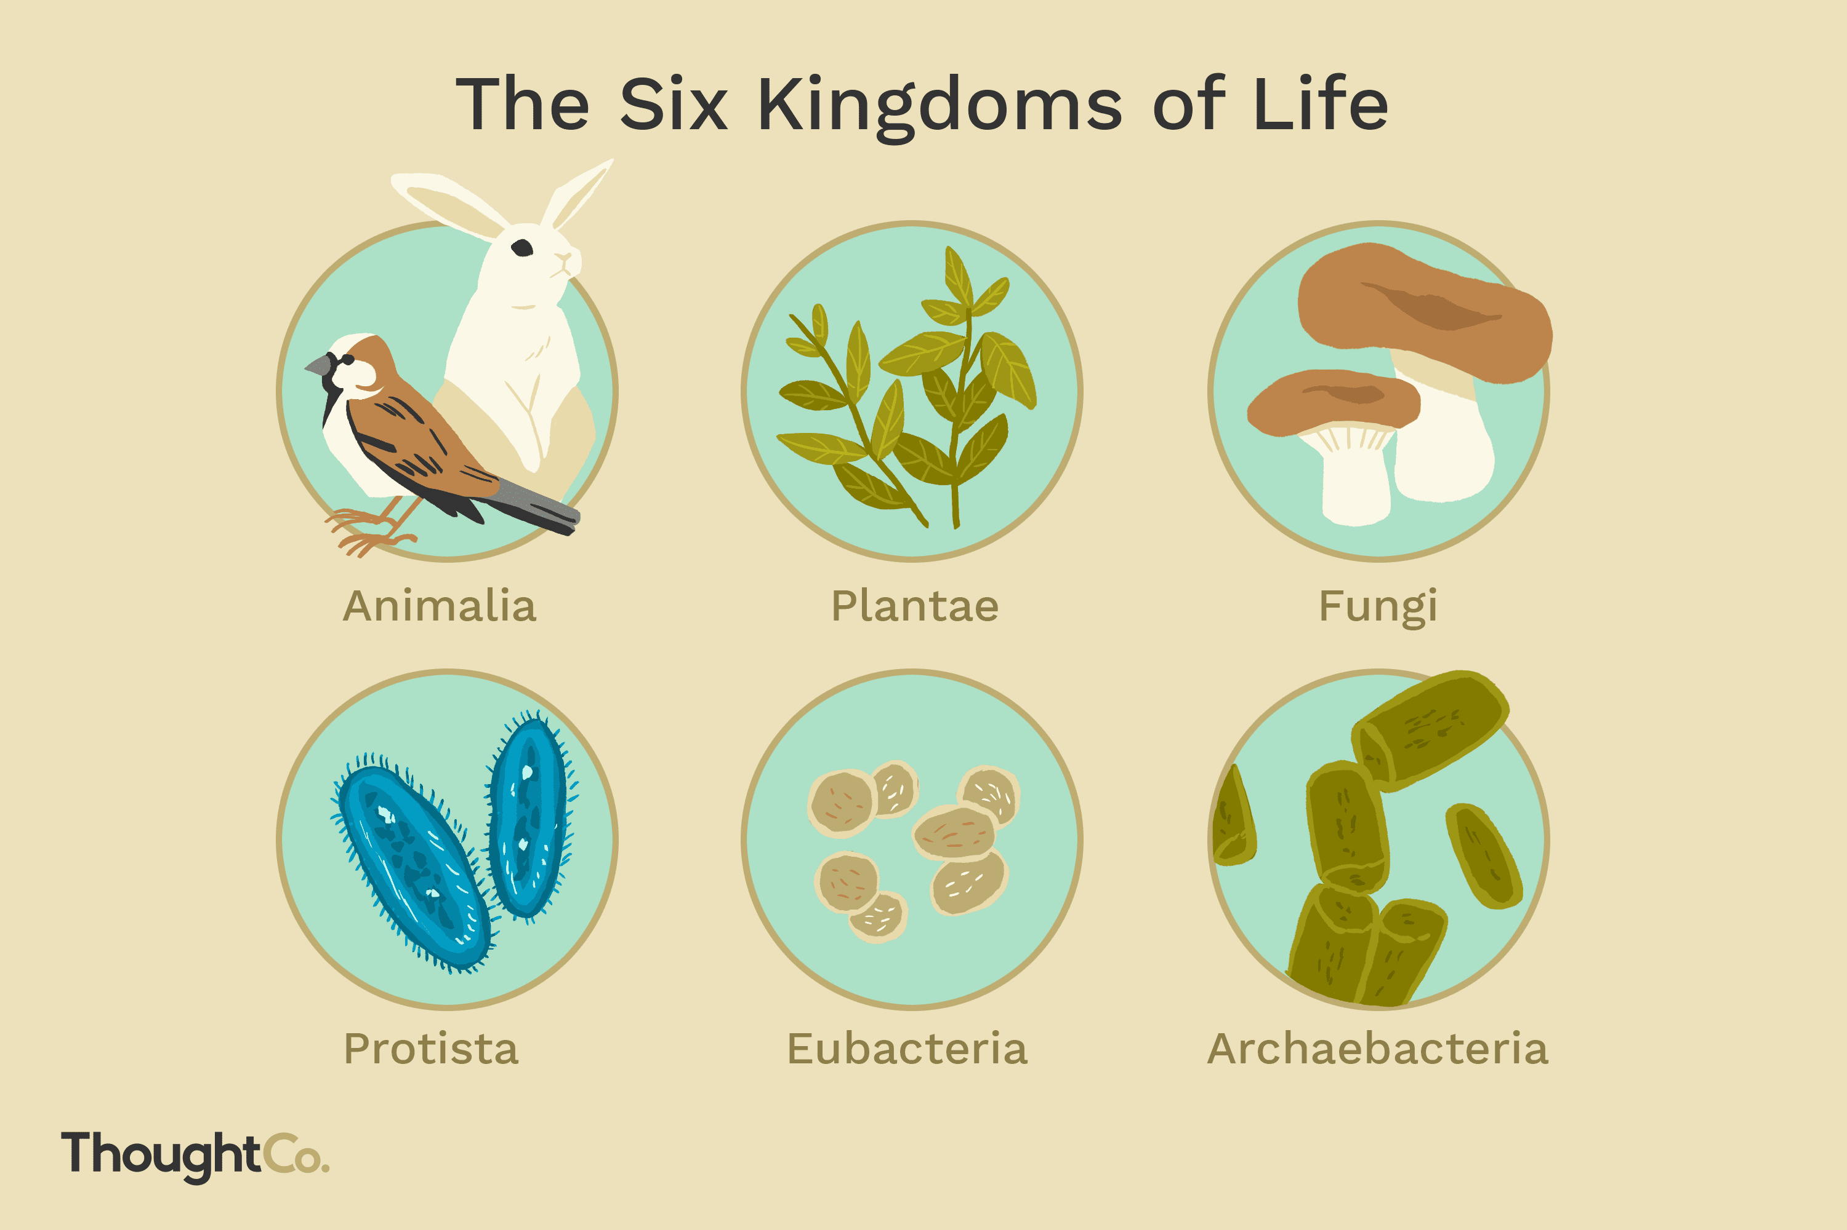
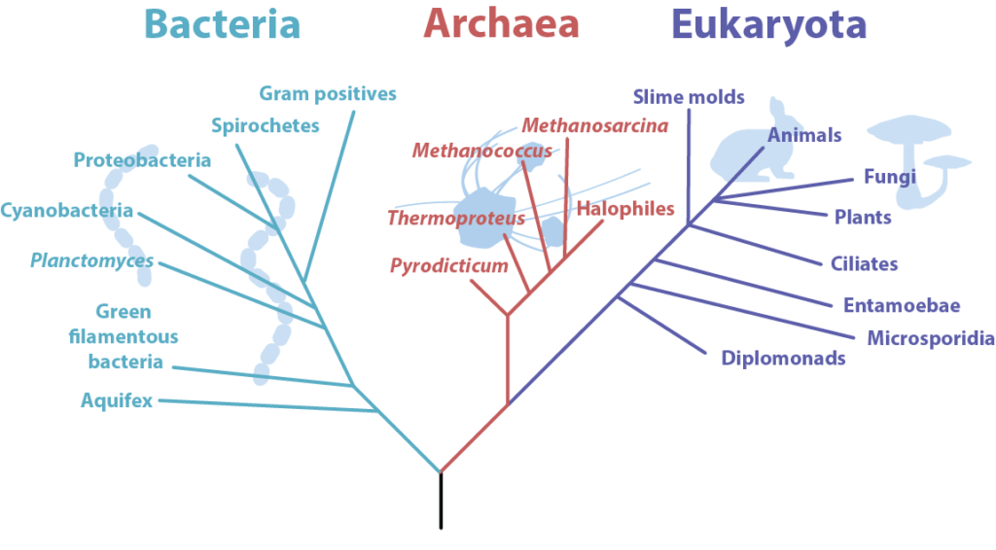
Prokaryotes vs Eukaryotes
Eukaryotes are organisms made of eukaryotic cells
Eukaryotes include animals, plants, algae, protists and fungi
A prokaryote is a prokaryotic cell
Prokaryotes include bacteria and archaea

Slide 4
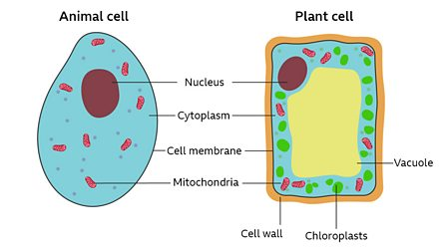
Plant vs Animal Cells
?
?
?
?
?
?
?

Slide 5
Organelle Functions (present in animal and plant cells)
Nucleus – controls all the activities of the cell and contains chromosomes with genetic material needed for protein synthesis.
Cytoplasm – a liquid gel which the organelles are suspended and the site for most enzymatic reactions and metabolic activity
Cell membrane – controls the movement of substances in and out of the cell
Mitochondria – where aerobic respiration takes place, releasing energy for the cell
Ribosomes – where protein synthesis happens
?
?
?
?
?

Slide 6
Organelle Functions (present only in plant cells)
Cell wall – made of cellulose, strengthens the cell and gives it support
Chloroplasts – where photosynthesis occurs, contains chlorophyll which absorbs light needed for photosynthesis
Permanent vacuole – a space in the cytoplasm filled with cell sap, important for keeping the cells rigid to support the plant
?
?
?

Slide 7
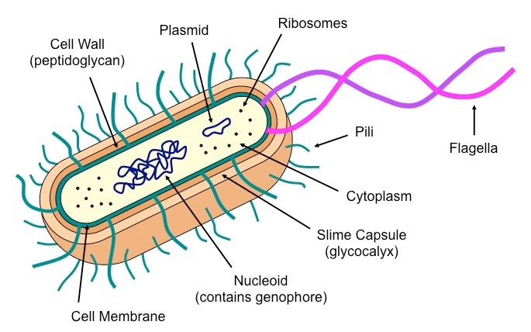
Prokaryotic cell structure
?
?
?
Prokaryotic cells have cytoplasm and a cell membrane surrounded by a cell wall.
The genetic material is not enclosed in a nucleus.
It is a single DNA loop and there may be one or more small rings of DNA called plasmids.
?
?
?

Slide 8
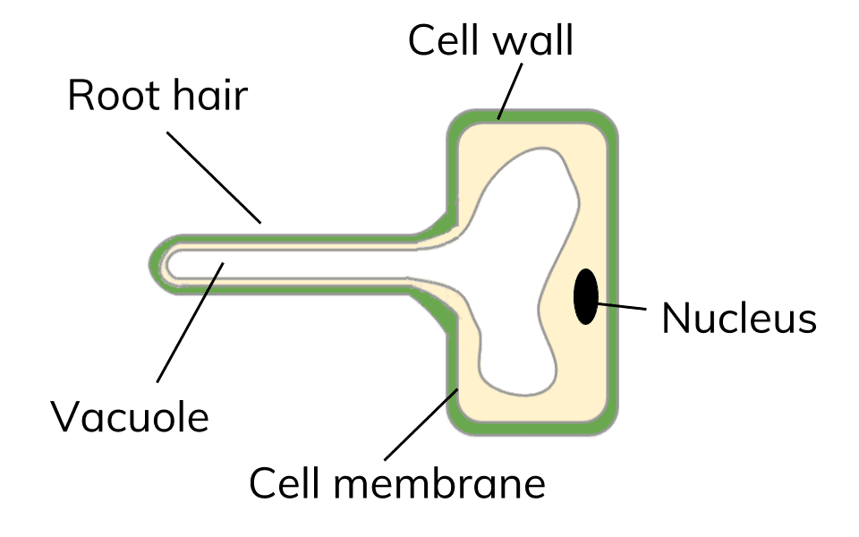
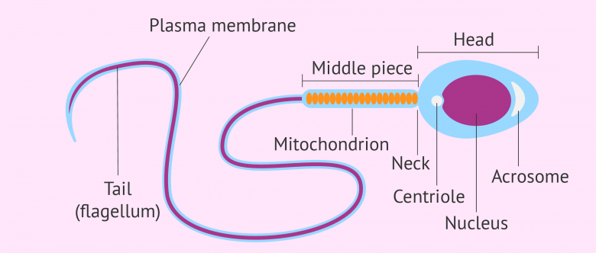
Cell Specialisation
Cells may be specialised to carry out a particular function.
You need to know sperm cells, nerve cells and muscle cells in animals as well as root hair cells, xylem and phloem cells in plants.

Slide 9
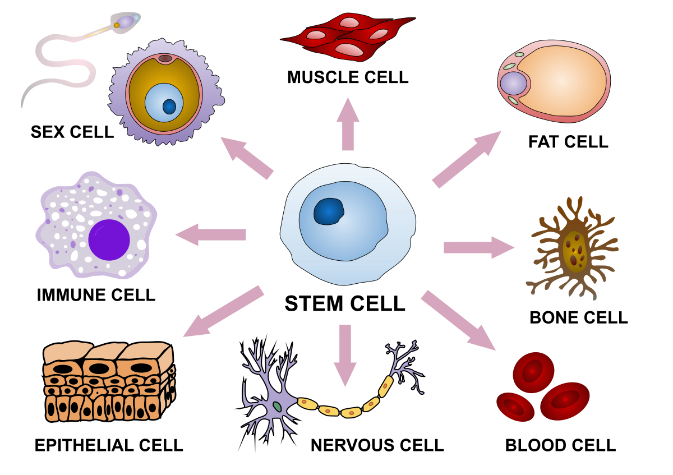
Cell Differentiation
As an organism develops, cells differentiate to form different types of cells.
Most types of animal cell differentiate at an early stage.
Many types of plant cells retain the ability to differentiate throughout life.
?
?

